Slide 1
Cyber Attacks and Risk Management
BCA
Cloud Computing & Information Security
Mr. Sukhdev Singh
Asst. Professor
Computer Science & IT
Jagannath University, Delhi (NCR)

Slide 2
Cyber Security Concepts
Overview of Cyber Security
Cyber security is the protection of Internet-connected systems, including hardware, software, and data from cyber attackers. It is primarily about people, processes, and technologies working together to encompass the full range of threat reduction, vulnerability reduction, deterrence, international engagement, and recovery policies and activities, including computer network operations, information assurance, law enforcement, etc.

Slide 3
Cyber Security Concepts
Overview of Cyber Security
It is the body of technologies, processes, and practices designed to protect networks, devices, programs, and data from attack, theft, damage, modification, or unauthorized access. Therefore, it may also be referred to as information technology security.

Slide 4
Cyber Security Concepts
What is Cyber Security?
The technique of protecting internet-connected systems such as computers, servers, mobile devices, electronic systems, networks, and data from malicious attacks is known as cyber security. We can divide cyber security into two parts one is cyber, and the other is security. Cyber refers to the technology that includes systems, networks, programs, and data. And security is concerned with the protection of systems, networks, applications, and information. In some cases, it is also called electronic information security or information technology security.

Slide 5

Cyber Security Concepts
Overview of Cyber Security
Some other definitions of cyber security are:
"Cyber Security is the body of technologies, processes, and practices designed to protect networks, devices, programs, and data from attack, theft, damage, modification or unauthorized access."
"Cyber Security is the set of
principles and practices designed
to protect our computing
resources and online information
against threats."

Slide 6
Cyber Security Concepts
History of Cyber Security
Cybercrime has evolved significantly since the first computers went online and started communicating with each other. The level of risk faced today is significantly more than it was then, but these threats seem to always have worried computer users, and with good reason.

Slide 7
Cyber Security Concepts
History of Cyber Security
Cybercriminals have played a role for a long time. Let’s take a decade by decade look at some of the factors impacting the industry.

Slide 8
Cyber Security Concepts
History of Cyber Security
The 1940s
The first digital computer was created in 1943. For the next several decades, there were limited ways for people to use computers in a criminal or risky manner. There were only a few of these computers located around the world. Most were very large, very noisy, and difficult to use. These electronic machines were not available to most people. Many didn’t know they existed.

Slide 9
Cyber Security Concepts
History of Cyber Security
The 1940s
What’s more, in the 1940s, there was no interconnecting network either. There was no connection between computers to move data or files. That created, what could be called, a safe climate. Threats were nearly non existent.
In the late part of the decade, though, many developed a theory about viruses. John von Neumann believed that some type of “mechanical organism” could occur. It would damage machines. It could copy itself like a naturally occurring virus. And, it could spread to new hosts as well. He developed this theory and wrote about it in Theory of Self Reproducing Automata, a paper he published later in 1966.

Slide 10
Cyber Security Concepts
History of Cyber Security
The 1950s
Hacking didn’t initially develop as a way to gather information with computers. Rather, the roots of computer hacking may be more effectively linked to early telephone use. This is evident in the 1950s when a trend called phone phreaking began.
Phone phreaks are people that had a significant interest in the way phones worked. They attempted to hijack the protocols in place that enabled engineers to work on the network from a distance.

Slide 11
Cyber Security Concepts
History of Cyber Security
The 1950s
This enabled people to make no cost calls and reduced tolls for long distance calling. This practice continued for some time. It left many phone companies without a way to stop it from occurring.
There are claims that Steve Jobs and Steve Wozniak, the founders of Apple, were interested in the phone phreaks community itself. Digital technology using similar concepts would later be developed in the Apple computers.

Slide 12
Cyber Security Concepts
History of Cyber Security
The 1960s
The 1960s brought with it various innovations in the computer industry. Still, computers were still very large and expensive systems. Most were huge mainframes that, when used, were locked into rooms far away from access to the general public or anyone else using them.
The term hacking developed during this decade, for the most part. It didn’t come from the use with computers, but rather when a group of people hacked the MIT Tech Model Railroad Club hacked high tech train sets. They wanted to make adjustments to their functionality

Slide 13
Cyber Security Concepts
History of Cyber Security
The 1970s
The true birth of cyber security occurred in the 1970s. This began with a project called The Advanced Research Projects Agency Network (ARPANET). This was the connectivity network developed prior to the internet itself.
A man named Bob Thomas determined it was possible for a computer program to move over a network. As it did so, the program would leave a trail as it moved. He developed the program so that it could move between the Tenex terminals on ARPANET.
Mr. Thomas called this program Creeper. Mr. Thomas created the program to carry and print a simple message. “I’M THE CREEPER: CATCH ME IF YOU CAN.”

Slide 14
Cyber Security Concepts
History of Cyber Security
The 1980s
With the advent of cyber attacks present, this decade brought numerous problems for computer networks. Number of high profile attacks would take place in this decade. That includes attacks on AT&T, the Los Alamos National Laboratory, and National CSS. It was in 1983 that new terms were developed to describe these attacks. Among them were “computer virus” and “Trojan Horse.”

Slide 15
Cyber Security Concepts
History of Cyber Security
The 1990s
The entire decade saw the incredible growth and development of the internet. The cybersecurity industry grew with it. Here are some key developments.
The DiskKiller virus was released by PC Today, a magazine aimed at computer users. It infected thousands of computers. The magazine edition offered the disc to subscribers. They stated it was an accident, and they did not know the risk was present. The first anti antivirus program was developed. It was developed by cybercriminals to circumvent these software programs.

Slide 16
Cyber Security Concepts
History of Cyber Security
The 1990s
In 1996, stealth capability was developed. This was also the same year macro viruses were released. Both created more challenges and required new developments of antivirus software. From the first antivirus on, the goal was to increase ways to protect against risks. As one hacker group developed after another, companies faced a lot of challenges to improve security to minimize data breaches.
More types of malicious programs were on the way. The ILOVEYOU virus and Melissa infected millions of computers in the 1990s targeting Microsoft Outlook. These viruses caused significant slowdowns and failures of email systems.

Slide 17
Cyber Security Concepts
History of Cyber Security
The 2000s
The growth of the internet was incredible during this period. Computers were in most homes and offices. While this helped consumers, it creates more risks and opportunities for criminals.
Early in the decade, a new type of infection occurred where there was no longer a need to download files. Just going to a website infected with the virus was enough. This type of hidden malware was damaging. It also infiltrated instant messaging services.

Slide 18
Cyber Security Concepts
History of Cyber Security
The 2000s
The first hacker group also developed at this time. These groups typically include people with specific hacking skills. They may launch a cyberattack campaign for various goals. One of the first to become more recognized when it hacked the Church of Scientology. To do so, it distributed denial of service attacks (DDoS attack). The group, called Anonymous, has continued to create attacks for various high profile targets.

Slide 19
Cyber Security Concepts
History of Cyber Security
The 2000s
Credit card hacks also occurred in the 2000s. This involved data breaches targeting credit cards. The Albert Gonzales group was of particular importance. This group managed to steal confidential information from 45.7 million credit cards. They gain access through a retailer’s database. This created a broader need to focus on information security by various sectors, including retailers.
Yahoo attacks also occurred during this time. In 2013 and 2014, these came to light. In one situation, more than 3 billion people with a Yahoo account had their accounts hacked. The hackers used spear phishing methods to do so. This created an opportunity through unlimited backdoor access.

Slide 20
Cyber Security Concepts
History of Cyber Security
The 2000s
While this continued to be an error or intensifying threats, solutions developed, too. New detection methods developed. New solutions for unprecedented threats were created. This included the use of new technology and approaches. Some examples include:
Computer forensics Multi factor authentication
Network Behavioral Analysis (NBA) Real time protection
Threat intelligence and updated automation
Sandboxing Back up and mirroring
Multi vector attacks Social engineering
Web application firewalls

Slide 21
Cyber Security Concepts
Cybercrime and its types
Every organization's assets are the combinations of a variety of different systems. These systems have a strong cyber security posture that requires coordinated efforts across all of its systems. Therefore, we can categorize cyber security in the following sub-domains:
Network Security: It involves implementing the hardware and software to secure a computer network from unauthorized access, intruders, attacks, disruption, and misuse. This security helps an organization to protect its assets against external and internal threats.

Slide 22
Cyber Security Concepts
Cybercrime and its types
Application Security: It involves protecting the software and devices from unwanted threats. This protection can be done by constantly updating the apps to ensure they are secure from attacks. Successful security begins in the design stage, writing source code, validation, threat modeling, etc., before a program or device is deployed.
Information or Data Security: It involves implementing a strong data storage mechanism to maintain the integrity and privacy of data, both in storage and in transit.
Identity management: It deals with the procedure for determining the level of access that each individual has within an organization.

Slide 23
Cyber Security Concepts
Cybercrime and its types
Operational Security: It involves processing and making decisions on handling and securing data assets.
Mobile Security: It involves securing the organizational and personal data stored on mobile devices such as cell phones, computers, tablets, and other similar devices against various malicious threats. These threats are unauthorized access, device loss or theft, malware, etc.
Cloud Security: It involves in protecting the information stored in the digital environment or cloud architectures for the organization. It uses various cloud service providers such as AWS, Azure, Google, etc., to ensure security against multiple threats.

Slide 24
Cyber Security Concepts
Cybercrime and its types
Disaster Recovery and Business Continuity Planning: It deals with the processes, monitoring, alerts, and plans to how an organization responds when any malicious activity is causing the loss of operations or data. Its policies dictate resuming the lost operations after any disaster happens to the same operating capacity as before the event.
User Education: It deals with the processes, monitoring, alerts, and plans to how an organization responds when any malicious activity is causing the loss of operations or data. Its policies dictate resuming the lost operations after any disaster happens to the same operating capacity as before the event.

Slide 25
Cyber Security Concepts
Importance of Cyber Security
Today we live in a digital era where all aspects of our lives depend on the network, computer and other electronic devices, and software applications. All critical infrastructure such as the banking system, healthcare, financial institutions, governments, and manufacturing industries use devices connected to the Internet as a core part of their operations. Some of their information, such as intellectual property, financial data, and personal data, can be sensitive for unauthorized access or exposure that could have negative consequences. This information gives intruders and threat actors to infiltrate them for financial gain, extortion, political or social motives, or just vandalism.

Slide 26
Cyber Security Concepts
Importance of Cyber Security
Cyber-attack is now an international concern that hacks the system, and other security attacks could endanger the global economy. Therefore, it is essential to have an excellent cyber security strategy to protect sensitive information from high-profile security breaches. Furthermore, as the volume of cyber-attacks grows, companies and organizations, especially those that deal with information related to national security, health, or financial records, need to use strong cyber security measures and processes to protect their sensitive business and personal information.

Slide 27
Cyber Security Concepts
Cyber Security Goals
Cyber Security's main objective is to ensure data protection. The security community provides a triangle of three related principles to protect the data from cyber-attacks. This principle is called the CIA triad. The CIA model is designed to guide policies for an organization's information security infrastructure. When any security breaches are found, one or more of these principles has been violated.

Slide 28
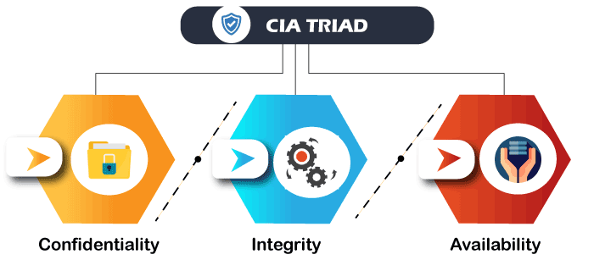
Cyber Security Concepts
Cyber Security Goals
We can break the CIA model into three parts: Confidentiality, Integrity, and Availability. It is actually a security model that helps people to think about various parts of IT security. Let us discuss each part in detail.

Slide 29
Cyber Security Concepts
Cyber Security Goals
Confidentiality:
Confidentiality is equivalent to privacy that avoids unauthorized access of information. It involves ensuring the data is accessible by those who are allowed to use it and blocking access to others. It prevents essential information from reaching the wrong people. Data encryption is an excellent example of ensuring confidentiality.

Slide 30
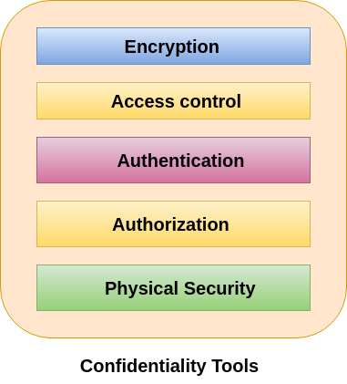
Cyber Security Concepts
Cyber Security Goals
Tools for Confidentiality:

Slide 31
Cyber Security Concepts
Cyber Security Goals
Tools for Confidentiality:
Encryption
Encryption is a method of transforming information to make it unreadable for unauthorized users by using an algorithm. The transformation of data uses a secret key (an encryption key) so that the transformed data can only be read by using another secret key (decryption key). It protects sensitive data such as credit card numbers by encoding and transforming data into unreadable cipher text. This encrypted data can only be read by decrypting it. Asymmetric-key and symmetric-key are the two primary types of encryption.

Slide 32
Cyber Security Concepts
Cyber Security Goals
Tools for Confidentiality:
Access control
Access control defines rules and policies for limiting access to a system or to physical or virtual resources. It is a process by which users are granted access and certain privileges to systems, resources or information. In access control systems, users need to present credentials before they can be granted access such as a person's name or a computer's serial number. In physical systems, these credentials may come in many forms, but credentials that can't be transferred provide the most security.

Slide 33
Cyber Security Concepts
Cyber Security Goals
Tools for Confidentiality:
Authentication
An authentication is a process that ensures and confirms a user's identity or role that someone has. It can be done in a number of different ways, but it is usually based on a combination of-
something the person has (like a smart card or a radio key for storing secret keys),
something the person knows (like a password),
something the person is (like a human with a fingerprint).

Slide 34
Cyber Security Concepts
Cyber Security Goals
Tools for Confidentiality:
Authorization
Authorization is a security mechanism which gives permission to do or have something. It is used to determine a person or system is allowed access to resources, based on an access control policy, including computer programs, files, services, data and application features. It is normally preceded by authentication for user identity verification. System administrators are typically assigned permission levels covering all system and user resources. During authorization, a system verifies an authenticated user's access rules and either grants or refuses resource access.

Slide 35
Cyber Security Concepts
Cyber Security Goals
Tools for Confidentiality:
Physical Security
Physical security describes measures designed to deny the unauthorized access of IT assets like facilities, equipment, personnel, resources and other properties from damage. It protects these assets from physical threats including theft, vandalism, fire and natural disasters.

Slide 36
Cyber Security Concepts
Cyber Security Goals
Integrity:
This principle ensures that the data is authentic, accurate, and safeguarded from unauthorized modification by threat actors or accidental user modification. If any modifications occur, certain measures should be taken to protect the sensitive data from corruption or loss and speedily recover from such an event. In addition, it indicates to make the source of information genuine.

Slide 37
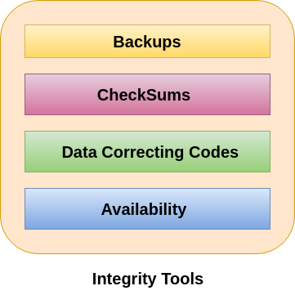
Cyber Security Concepts
Cyber Security Goals
Tools for Integrity

Slide 38
Cyber Security Concepts
Cyber Security Goals
Tools for Integrity
Backups
Backup is the periodic archiving of data. It is a process of making copies of data or data files to use in the event when the original data or data files are lost or destroyed. It is also used to make copies for historical purposes, such as for longitudinal studies, statistics or for historical records or to meet the requirements of a data retention policy. Many applications especially in a Windows environment, produce backup files using the .BAK file extension.

Slide 39
Cyber Security Concepts
Cyber Security Goals
Tools for Integrity
Checksums
A checksum is a numerical value used to verify the integrity of a file or a data transfer. In other words, it is the computation of a function that maps the contents of a file to a numerical value. They are typically used to compare two sets of data to make sure that they are the same. A checksum function depends on the entire contents of a file. It is designed in a way that even a small change to the input file (such as flipping a single bit) likely to results in different output value.

Slide 40
Cyber Security Concepts
Cyber Security Goals
Tools for Integrity
Data Correcting Codes
It is a method for storing data in such a way that small changes can be easily detected and automatically corrected.

Slide 41
Cyber Security Concepts
Cyber Security Goals
Availability:
This principle makes the information to be available and useful for its authorized people always. It ensures that these accesses are not hindered by system malfunction or cyber-attacks.
Tools for Availability
Physical Protections:
Computational Redundancies:

Slide 42
Cyber Security Concepts
Cyber Security Goals
Physical Protections
Physical safeguard means to keep information available even in the event of physical challenges. It ensure sensitive information and critical information technology are housed in secure areas.
Physical Protections
Physical safeguard means to keep information available even in the event of physical challenges. It ensure sensitive information and critical information technology are housed in secure areas.

Slide 43
Cyber Security Concepts
Types of Cyber Attackers
In computer and computer networks, an attacker is the individual or organization who performs the malicious activities to destroy, expose, alter, disable, steal or gain unauthorized access to or make unauthorized use of an asset.
As the Internet access becomes more pervasive across the world, and each of us spends more time on the web, there is also an attacker grows as well. Attackers use every tools and techniques they would try and attack us to get unauthorized access.

Slide 44
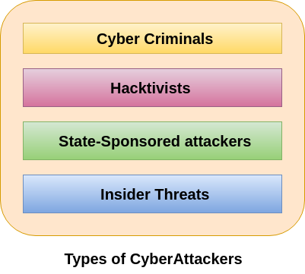
Cyber Security Concepts
Types of Cyber Attackers
There are four types of attackers which are described below-

Slide 45
Cyber Security Concepts
Types of Cyber Attackers
Cyber Criminals
Cybercriminals are individual or group of people who use technology to commit cybercrime with the intention of stealing sensitive company information or personal data and generating profits. In today's, they are the most prominent and most active type of attacker.

Slide 46
Cyber Security Concepts
Types of Cyber Attackers
Cyber Criminals
Cybercriminals use computers in three broad ways to do cybercrimes-
Select computer as their target- In this, they attack other people's computers to do cybercrime, such as spreading viruses, data theft, identity theft, etc.
Uses the computer as their weapon- In this, they use the computer to do conventional crime such as spam, fraud, illegal gambling, etc.
Uses the computer as their accessory- In this, they use the computer to steal data illegally.

Slide 47
Cyber Security Concepts
Types of Cyber Attackers
Hacktivists
Hacktivists are individuals or groups of hackers who carry out malicious activity to promote a political agenda, religious belief, or social ideology. According to Dan Lohrmann, chief security officer for Security Mentor, a national security training firm that works with states said "Hacktivism is a digital disobedience. It's hacking for a cause." Hacktivists are not like cybercriminals who hack computer networks to steal data for the cash. They are individuals or groups of hackers who work together and see themselves as fighting injustice.

Slide 48
Cyber Security Concepts
Types of Cyber Attackers
State-sponsored Attacker
State-sponsored attackers have particular objectives aligned with either the political, commercial or military interests of their country of origin. These type of attackers are not in a hurry. The government organizations have highly skilled hackers and specialize in detecting vulnerabilities and exploiting these before the holes are patched. It is very challenging to defeat these attackers due to the vast resources at their disposal.

Slide 49
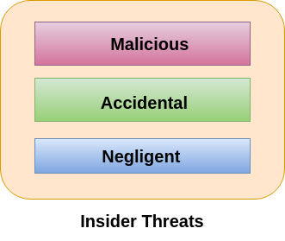
Cyber Security Concepts
Types of Cyber Attackers
Insider Threats
The insider threat is a threat to an organization's security or data that comes from within. These type of threats are usually occurred from employees or former employees, but may also arise from third parties, including contractors, temporary workers, employees or customers.
Insider threats can be categorized below-

Slide 50
Cyber Security Concepts
Types of Cyber Attackers
Malicious-
Malicious threats are attempts by an insider to access and potentially harm an organization's data, systems or IT infrastructure. These insider threats are often attributed to dissatisfied employees or ex-employees who believe that the organization was doing something wrong with them in some way, and they feel justified in seeking revenge.
Insiders may also become threats when they are disguised by malicious outsiders, either through financial incentives or extortion.

Slide 51
Cyber Security Concepts
Types of Cyber Attackers
Accidental-
Accidental threats are threats which are accidently done by insider employees. In this type of threats, an employee might accidentally delete an important file or inadvertently share confidential data with a business partner going beyond company?s policy or legal requirements.

Slide 52
Cyber Security Concepts
Types of Cyber Attackers
Negligent-
These are the threats in which employees try to avoid the policies of an organization put in place to protect endpoints and valuable data. For example, if the organization have strict policies for external file sharing, employees might try to share work on public cloud applications so that they can work at home. There is nothing wrong with these acts, but they can open up to dangerous threats nonetheless.

Slide 53
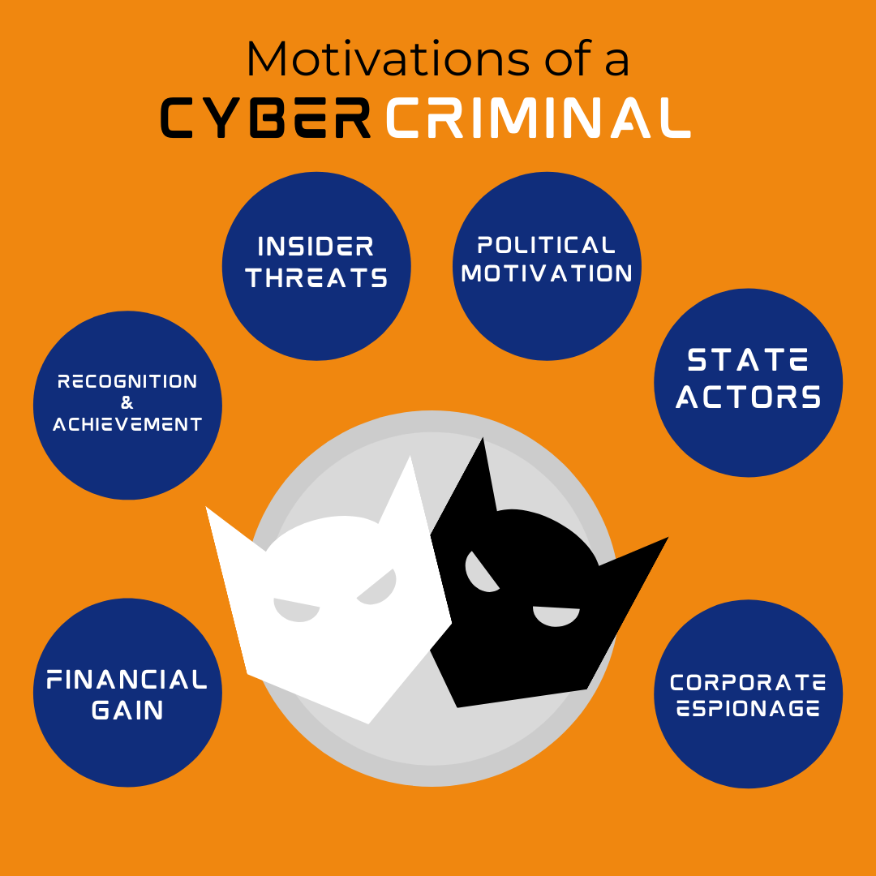
Cyber Security Concepts
Motivations for hacking
While there are several motivations for hackers, we’ve covered 6 of the most common ones.

Slide 54
Cyber Security Concepts
Motivations for hacking
Financial Gain
The primary motivation of a hacker is money, and getting it can be done with a variety of methods.
They could directly gain entry to a bank or investment account; steal a password to your financial sites and then transfer the assets over to one of their own; swindle an employee into completing a money transfer through a complicated spear phishing technique, or conduct a ransomware attack on your entire organization.
The possibilities are endless, but most hackers are out to make a profit.

Slide 55
Cyber Security Concepts
Motivations for hacking
Recognition & Achievement
Some hackers are motivated by the sense of achievement that comes with cracking open a major system. Some may work in groups or independently, but, on some scale, they would like to be recognized.
This also ties into the fact that cyber criminals are competitive by nature, and they love the challenge their actions bring. In fact, they often drive one another to complete more complicated hacks.

Slide 56
Cyber Security Concepts
Motivations for hacking
Insider Threats
Individuals who have access to critical information or systems can easily choose to misuse that access—to the detriment of their organization.
These threats can come from internal employees, vendors, a contractor or a partner—and are viewed as some of the greatest cyber security threats to organizations.

Slide 57
Cyber Security Concepts
Motivations for hacking
Political Motivation – “Hacktivism”
Some cyber criminal groups use their hacking skills to go after large organizations. They are usually motivated by a cause of some sort, such as highlighting human rights or alerting a large corporation to their system vulnerabilities. Or, they may go up against groups whose ideologies do not align with their own.
These groups can steal information and argue that they are practicing free speech, but more often than not, these groups will employ a DDoS (Distributed Denial of Service) attack to overload a website with too much traffic and cause it to crash.

Slide 58
Cyber Security Concepts
Motivations for hacking
State Actors
State-sponsored actors receive funding and assistance from a nation-state. They are specifically engaged in cyber crime to further their nation’s own interests. Typically, they steal information, including “intellectual property, personally identifying information, and money to fund or further espionage and exploitation causes.”
However, some state-sponsored actors do conduct damaging cyberattacks and claim that their cyberespionage actions are legitimate activity on behalf of the state.

Slide 59
Cyber Security Concepts
Motivations for hacking
Corporate Espionage
This is a form of cyber attack used to gain an advantage over a competing organization.
Conducted for commercial or financial purposes, corporate espionage involves:
Acquiring property like processes or techniques, locations, customer data, pricing, sales, research, bids, or strategies
Theft of trade secrets, bribery, blackmail, or surveillance.

Slide 60
Cyber Security Concepts
Cyber Security Challenges
Today cybersecurity is the main component of the country's overall national security and economic security strategies. In India, there are so many challenges related to cybersecurity. With the increase of the cyber-attacks, every organization needs a security analyst who makes sure that their system is secured. These security analysts face many challenges related to cybersecurity such as securing confidential data of government organizations, securing the private organization servers, etc.

Slide 61
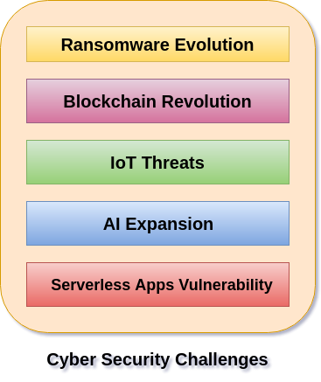
Cyber Security Concepts
Cyber Security Challenges
The recent important cyber security challenges are described below:

Slide 62
Cyber Security Concepts
Cyber Security Challenges
Ransomware Evolution
Ransomware is a type of malware in which the data on a victim's computer is locked, and payment is demanded before the ransomed data is unlocked. After successful payment, access rights returned to the victim. Ransomware is the bane of cybersecurity, data professionals, IT, and executives.

Slide 63
Cyber Security Concepts
Cyber Security Challenges
Ransomware Evolution
Ransomware attacks are growing day by day in the areas of cybercrime. IT professionals and business leaders need to have a powerful recovery strategy against the malware attacks to protect their organization. It involves proper planning to recover corporate and customers' data and application as well as reporting any breaches against the Notifiable Data Breaches scheme. Today's DRaaS solutions are the best defence against the ransomware attacks. With DRaaS solutions method, we can automatically back up our files, easily identify which backup is clean, and launch a fail-over with the press of a button when malicious attacks corrupt our data.

Slide 64
Cyber Security Concepts
Cyber Security Challenges
Blockchain Revolution
Blockchain technology is the most important invention in computing era. It is the first time in human history that we have a genuinely native digital medium for peer-to-peer value exchange. The blockchain is a technology that enables cryptocurrencies like Bitcoin. The blockchain is a vast global platform that allows two or more parties to do a transaction or do business without needing a third party for establishing trust.

Slide 65
Cyber Security Concepts
Cyber Security Challenges
Blockchain Revolution
It is difficult to predict what blockchain systems will offer in regards to cybersecurity. The professionals in cybersecurity can make some educated guesses regarding blockchain. As the application and utility of blockchain in a cybersecurity context emerges, there will be a healthy tension but also complementary integrations with traditional, proven, cybersecurity approaches.

Slide 66
Cyber Security Concepts
Cyber Security Challenges
IoT Threats
IoT stands for Internet of Things. It is a system of interrelated physical devices which can be accessible through the internet. The connected physical devices have a unique identifier (UID) and have the ability to transfer data over a network without any requirements of the human-to-human or human-to-computer interaction. The firmware and software which is running on IoT devices make consumer and businesses highly susceptible to cyber-attacks.

Slide 67
Cyber Security Concepts
Cyber Security Challenges
IoT Threats
When IoT things were designed, it is not considered in mind about the used in cybersecurity and for commercial purposes. So every organization needs to work with cybersecurity professionals to ensure the security of their password policies, session handling, user verification, multifactor authentication, and security protocols to help in managing the risk.

Slide 68
Cyber Security Concepts
Cyber Security Challenges
AI Expansion
AI short form is Artificial intelligence. According to John McCarthy, father of Artificial Intelligence defined AI: "The science and engineering of making intelligent machines, especially intelligent computer programs."

Slide 69
Cyber Security Concepts
Cyber Security Challenges
AI Expansion
It is an area of computer science which is the creation of intelligent machines that do work and react like humans. Some of the activities related to artificial intelligence include speech recognition, Learning, Planning, Problem-solving, etc. The key benefits with AI into our cybersecurity strategy has the ability to protect and defend an environment when the malicious attack begins, thus mitigating the impact. AI take immediate action against the malicious attacks at a moment when a threats impact a business. IT business leaders and cybersecurity strategy teams consider AI as a future protective control that will allow our business to stay ahead of the cybersecurity technology curve.

Slide 70
Cyber Security Concepts
Cyber Security Challenges
Serverless Apps Vulnerability
Serverless architecture and apps is an application which depends on third-party cloud infrastructure or on a back-end service such as google cloud function, Amazon web services (AWS) lambda, etc. The serverless apps invite the cyber attackers to spread threats on their system easily because the users access the application locally or off-server on their device. Therefore it is the user responsibility for the security precautions while using serverless application.

Slide 71
Cyber Security Concepts
Cyber Security Challenges
Serverless Apps Vulnerability
The serverless apps do nothing to keep the attackers away from our data. The serverless application doesn't help if an attacker gains access to our data through a vulnerability such as leaked credentials, a compromised insider or by any other means then serverless.
We can run software with the application which provides best chance to defeat the cybercriminals. The serverless applications are typically small in size. It helps developers to launch their applications quickly and easily. They don't need to worry about the underlying infrastructure. The web-services and data processing tools are examples of the most common serverless apps.

Slide 72
Cyber Security Concepts
Cyber Security Challenges
Serverless Apps Vulnerability
The serverless apps do nothing to keep the attackers away from our data. The serverless application doesn't help if an attacker gains access to our data through a vulnerability such as leaked credentials, a compromised insider or by any other means then serverless.
We can run software with the application which provides best chance to defeat the cybercriminals. The serverless applications are typically small in size. It helps developers to launch their applications quickly and easily. They don't need to worry about the underlying infrastructure. The web-services and data processing tools are examples of the most common serverless apps.

Slide 73
Cyber Security Concepts
The NIST Cybersecurity Framework
What is the NIST Cybersecurity Framework?
Overview
The NIST cybersecurity framework is a powerful tool to organize and improve your cybersecurity program. It is a set of guidelines and best practices to help organizations build and improve their cybersecurity posture. The framework puts forth a set of recommendations and standards that enable organizations to be better prepared in identifying and detecting cyber-attacks, and also provides guidelines on how to respond, prevent, and recover from cyber incidents.

Slide 74
Cyber Security Concepts
The NIST Cybersecurity Framework
What is the NIST Cybersecurity Framework?
Overview
Drafted by the National Institute of Standards and Technology (NIST), this framework addresses the lack of standards when it comes to cybersecurity and provides a uniform set of rules, guidelines, and standards for organizations to use across industries. The NIST Cybersecurity Framework (NIST CSF) is widely considered to be the gold-standard for building a cybersecurity program. Whether you’re just getting started in establishing a cybersecurity program or you’re already running a fairly mature program, the framework can provide value — by acting as a top-level security management tool that helps assess cybersecurity risk across the organization.

Slide 75
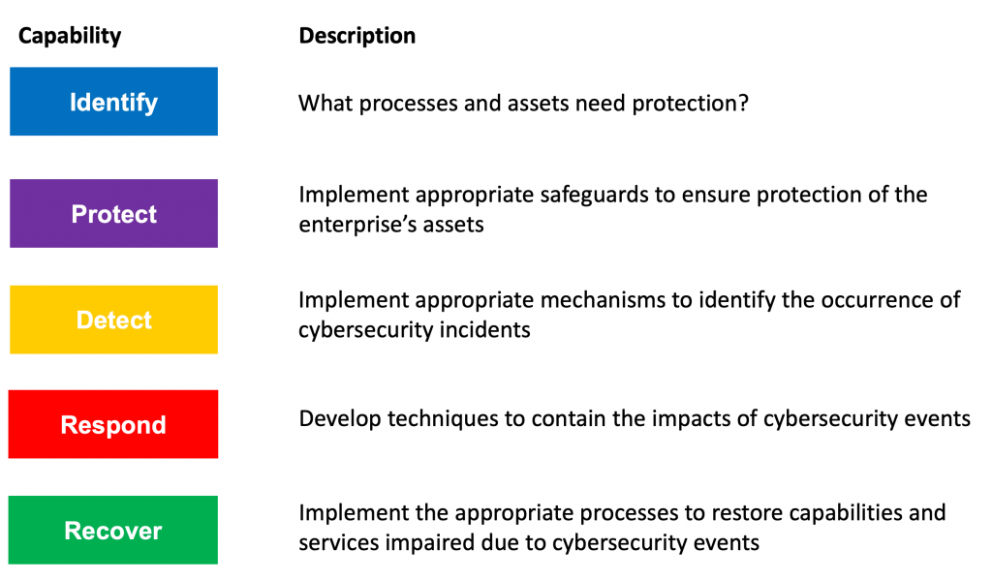
Cyber Security Concepts
The NIST Cybersecurity Framework
The framework categorizes all cybersecurity capabilities, projects, processes, daily activities into these 5 core functions:

Slide 76
Cyber Security Concepts
The NIST Cybersecurity Framework
IDENTIFY
The Identify function is focused on laying the groundwork for an effective cybersecurity program. This function assists in developing an organizational understanding to manage cybersecurity risk to systems, people, assets, data, and capabilities. To enable an organization to focus and prioritize its efforts, consistent with its risk management strategy and business needs, this function stressed the importance of understanding the business context, the resources that support critical functions, and the related cybersecurity risks. Essential activities in this group include:

Slide 77
Cyber Security Concepts
The NIST Cybersecurity Framework
IDENTIFY
Identifying physical and software assets to establish the basis of an asset management program
Identifying the organization’s business environment including its role in the supply chain
Identifying established cybersecurity policies to define the governance program as well as identifying legal and regulatory requirements regarding the cybersecurity capabilities of the organization
Identifying asset vulnerabilities, threats to internal and external organizational resources, and risk response activities to assess risk
Establishing a risk management strategy including identifying risk tolerance
Identifying a supply chain risk management strategy including priorities, constraints, risk tolerances, and assumptions used to support risk decisions associated with managing supply chain risks

Slide 78
Cyber Security Concepts
The NIST Cybersecurity Framework
PROTECT
The Protect function outlines appropriate safeguards to ensure delivery of critical infrastructure services and supports the ability to limit or contain the impact of a potential cybersecurity event. Critical activities in this group include:
Implementing protections for Identity Management and Access Control within the organization including physical and remote access
Empowering staff through security awareness training including role based and privileged user training
Establishing data security protection consistent with the organization’s risk strategy to protect the confidentiality, integrity, and availability of information

Slide 79
Cyber Security Concepts
The NIST Cybersecurity Framework
PROTECT
Implementing processes and procedures to maintain and manage the protections of information systems and assets
Protecting organizational resources through maintenance, including remote maintenance activities
Managing technology to ensure the security and resilience of systems, consistent with organizational policies, procedures, and agreements

Slide 80
Cyber Security Concepts
The NIST Cybersecurity Framework
DETECT
Detecting potential cybersecurity incidents is critical and this function defines the appropriate activities to identify the occurrence of a cybersecurity event in a timely manner. Activities in this function include:
Ensuring anomalies and events are detected, and their potential impact is understood
Implementing continuous monitoring capabilities to monitor cybersecurity events and verify the effectiveness of protective measures including network and physical activities

Slide 81
Cyber Security Concepts
The NIST Cybersecurity Framework
RESPOND
The Respond function focuses on appropriate activities to take action in case of a detected cybersecurity incident and supports the ability to contain the impact of a potential cybersecurity incident. The essential activities for this function include:
Ensuring response planning process are executed during and after an incident
Managing communications with internal and external stakeholders during and after an event

Slide 82
Cyber Security Concepts
The NIST Cybersecurity Framework
RESPOND
Analyzing the incident to ensure effective response and supporting recovery activities including forensic analysis and determining the impact of incidents
Performing mitigation activities to prevent expansion of an event and to resolve the incident
Implementing improvements by incorporating lessons learned from current and previous detection / response activities

Slide 83
Cyber Security Concepts
The NIST Cybersecurity Framework
RECOVER
The Recover function identifies appropriate activities to renew and maintain plans for resilience and to restore any capabilities or services that were impaired due to a cybersecurity incident. Timely recovery to normal operations is impressed upon, to reduce the impact from a cybersecurity incident. Essential activities for this function somewhat overlap with those of Respond and include:
Ensuring the organization implements recovery planning processes and procedures to restore systems and/or assets affected by cybersecurity incidents

Slide 84
Cyber Security Concepts
The NIST Cybersecurity Framework
RECOVER
Implementing improvements based on lessons learned and reviews of existing strategies
Internal and external communications are coordinated during and following the recovery from a cybersecurity incident

Slide 85
Cyber Security Concepts
Current Security Trends.
AI and ML in Cybersecurity
Integrating artificial intelligence (AI) and machine learning (ML) will play a pivotal role in cybersecurity. AI-powered threat detection, anomaly detection, and automated response systems will become more sophisticated in identifying and mitigating cyber threats. Adversarial AI and ML attacks will also challenge cybersecurity professionals to develop robust defenses.

Slide 86
Cyber Security Concepts
Current Security Trends.
Zero Trust Security Models
Adopting Zero Trust Architecture (ZTA) will expand further as organizations recognize the limitations of traditional perimeter-based security models. ZTA's principles of continuous verification and the principle of "never trust, always verify" will become more widespread to secure sensitive data and resources.

Slide 87
Cyber Security Concepts
Current Security Trends.
Quantum Computing Resistant Cryptography
The development of quantum computing-resistant cryptography will be essential as quantum computing technology advances. Organizations will need to transition to cryptographic algorithms that can withstand quantum attacks, ensuring the continued security of data and communications.

Slide 88
Cyber Security Concepts
Current Security Trends.
Cloud Security Evolution
Cloud security is always a priority, with organizations focusing on securing their cloud-native environments and addressing the challenges of misconfigurations and data exposure. Technologies like CASBs and CSPM will gain prominence.

Slide 89
Cyber Security Concepts
Current Security Trends.
5G Network Security
With the rollout of 5G networks, there will be an increased emphasis on 5G network security. Faster speeds and lower latency will introduce new security challenges, including protecting IoT devices connected to 5G networks and ensuring the integrity of critical infrastructure.

Slide 90
Cyber Security Concepts
Current Security Trends.
IoT Security
As the IoT ecosystem expands, securing IoT devices will be critical. Enhanced security standards, regulations, and improved IoT device management will be essential to mitigate risks associated with insecure IoT devices.

Slide 91
Cyber Security Concepts
Current Security Trends.
Supply Chain Security
Organizations will strongly emphasize supply chain security to prevent and detect attacks targeting the software and hardware supply chain. Enhanced visibility into the supply chain and stringent security measures will be implemented to reduce the risk of compromise.

Slide 92
Cyber Security Concepts
Current Security Trends.
Biometric and Behavioral Authentication
Secure authentication methods, such as facial recognition and fingerprint scanning, will evolve to offer more robust security, with liveness detection and behavioral analytics to prevent spoofing. Multi-modal biometric authentication will become more prevalent.

Slide 93
Cyber Security Concepts
Current Security Trends.
Privacy Regulations and Data Protection
Privacy regulations will continue evolving, and organizations must adapt to stricter data protection requirements. Consumer data privacy and consent management will become more significant, and businesses must ensure compliance with global data privacy laws.

Slide 94
Cyber Security Concepts
Current Security Trends.
Cybersecurity Workforce Development
Efforts to address the cybersecurity skills shortage will intensify. More comprehensive training programs, certifications, and partnerships between academic institutions and the private sector will be established to nurture a skilled cybersecurity workforce.

Slide 95
Cyber Security Concepts
Current Security Trends.
Human-Centric Security
User-centric security awareness and training programs will be expanded to reduce the risk of social engineering attacks. Behavioral analytics and user-focused security tools will help identify unusual user behavior and potential insider threats.

Slide 96
Cyber Security Concepts
Current Security Trends.
Automated Threat Hunting
Automated threat hunting and threat intelligence platforms will gain prominence in proactively identifying and mitigating emerging threats. These solutions will help organizations stay ahead of threat actors by continuously monitoring for signs of compromise.

Slide 97
Cyber Security Concepts
Current Security Trends.
International Cybersecurity Collaboration
Collaboration between governments, international organizations, and cybersecurity experts will intensify to address global cyber threats effectively. Cybersecurity information sharing and coordinated responses to cyber incidents will become more common.

Slide 98
Cyber Security Concepts
Current Security Trends.
Regulatory and Legal Challenges
With new cybersecurity laws, standards, and compliance requirements being introduced, the legal and regulatory landscape will continue to evolve. Organizations must navigate these complex regulations to avoid legal consequences and reputational damage.

Slide 99
Cyber Security Concepts
Current Security Trends.
Cyber Insurance
The cyber insurance market will grow as organizations recognize the need for financial protection against cyber incidents. Cyber insurance policies will become more tailored to specific industry risks and compliance requirements.

Slide 100
Cyber Security Concepts
Current Security Trends.
AI-Driven Security Testing
AI-powered penetration testing and vulnerability assessment tools will become more sophisticated in identifying weaknesses in systems and applications, allowing organizations to address security flaws proactively.
.

Slide 101
Cyber Security Concepts
Current Security Trends.
Incident Response and Recovery Planning
The development and testing of incident response and recovery plans will be a focus for organizations. The capacity to detect and respond to cyber incidents and recover from them will be critical to minimizing the impact of breaches.

Slide 102
Cyber Security Concepts
Current Security Trends.
Smart Cities and Critical Infrastructure Security
As smart city initiatives and the digitization of critical infrastructure expand, security measures for these interconnected systems will be paramount. Protecting essential services like power grids and transportation systems will be a top priority.

Slide 103
Cyber Security Concepts
Current Security Trends.
AI-Powered Cybercriminals
Cybercriminals will increasingly employ AI and ML in their attacks, making them more challenging to detect and mitigate. Adversarial AI will be used to evade security measures and enhance attack strategies.

Slide 104
Cyber Security Concepts
Current Security Trends.
Ethical Hacking and Bug Bounty Programs
Organizations will continue to embrace ethical hacking and bug bounty programs to detect system vulnerabilities. Crowdsourced security testing will become more common, allowing organizations to proactively fix security issues.

Slide 105
Keep Learning
Thank You!

